Slide 1
Monopoly
United International University
Microeconomics
Chapter-15
Faculty:

Slide 2
Monopoly- Imperfect Market
While a competitive firm is a price taker, a monopoly firm is a price maker.
A firm is considered a monopoly if . . .
it is the sole seller of its product.
its product does not have close substitutes.
Ex- DWASA, Bangladesh Rail Way
WHY MONOPOLIES ARISE?
The fundamental cause of monopoly is barriers to entry.
Barriers to entry have three sources:
Ownership of a key resource.
The government gives a single firm the exclusive right to produce some good.
Costs of production make a single producer more efficient than a large number of producers.

Slide 3
WHY MONOPOLIES ARISE?
Monopoly Resources: Although exclusive ownership of a key resource is a potential source of monopoly, in practice monopolies rarely arise for this reason.
Government-Created Monopolies: Governments may restrict entry by giving a single firm the exclusive right to sell a particular good in certain markets.
Patent and copyright laws are two important examples of how government creates a monopoly to serve the public interest.
Natural Monopolies: An industry is a natural monopoly when a single firm can supply a good or service to an entire market at a smaller cost than could two or more firms.
A natural monopoly arises when there are economies of scale over the relevant range of output.

Slide 4
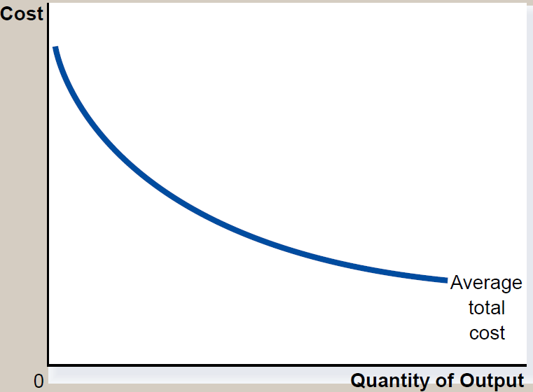
Economies of Scale as a Cause of Monopoly

Slide 5
PRODUCTION AND PRICING DECISIONS
Monopoly versus Competition
Monopoly
Single producer
Faces a downward-sloping demand curve(P=AR)
price maker
Reduces price to increase sales
Downward sloping Marginal curve and MR<P
Competitive Firm
Many producers
Faces a horizontal demand curve, P=MR=AR
Price taker
Sells as much or as little at same price

Slide 6
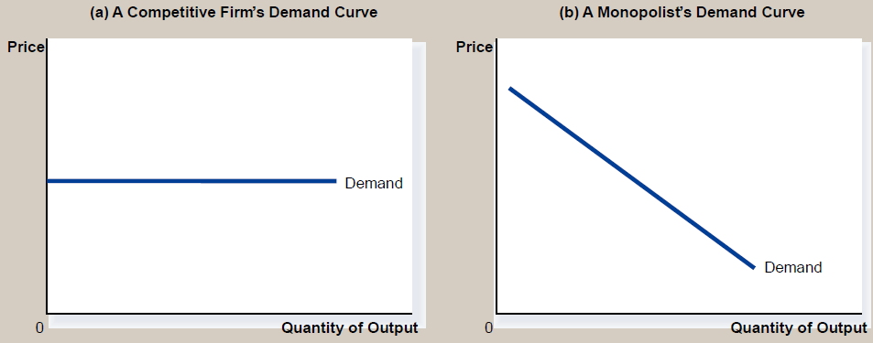
Demand Curves for Competitive and Monopoly Firms

Slide 7
A Monopoly’s Revenue
Total Revenue P × Q = TR
Average Revenue TR/Q = AR = P
Marginal Revenue ΔTR/ΔQ = MR
A Monopoly’s Marginal Revenue
A monopolist’s marginal revenue is always less than the price of its good.
The demand curve is downward sloping.
When a monopoly drops the price to sell one more unit, the revenue received from previously sold units also decreases.
A Monopoly’s Marginal Revenue
When a monopoly increases the amount it sells, it has two effects on total revenue (P × Q).
The output effect—more output is sold, so Q is higher.
The price effect—price falls, so P is lower.

Slide 8
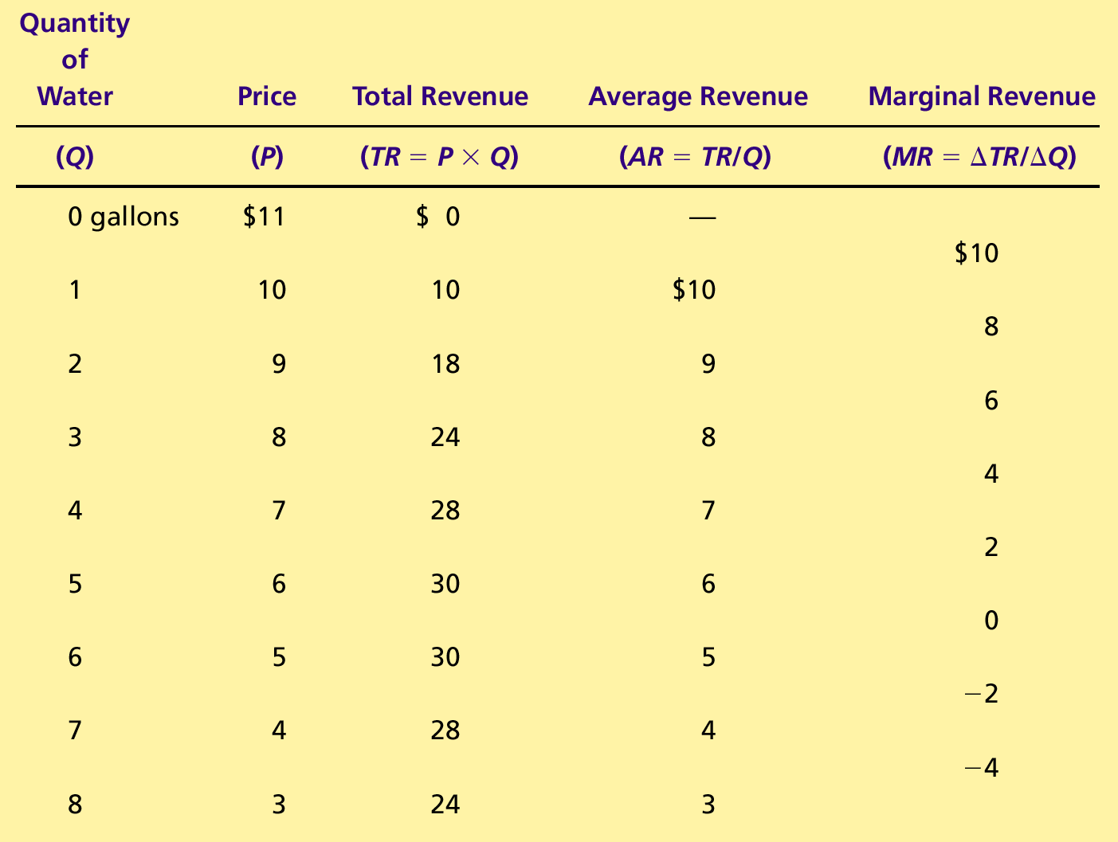
A Monopoly’s Total, Average, and Marginal Revenue

Slide 9
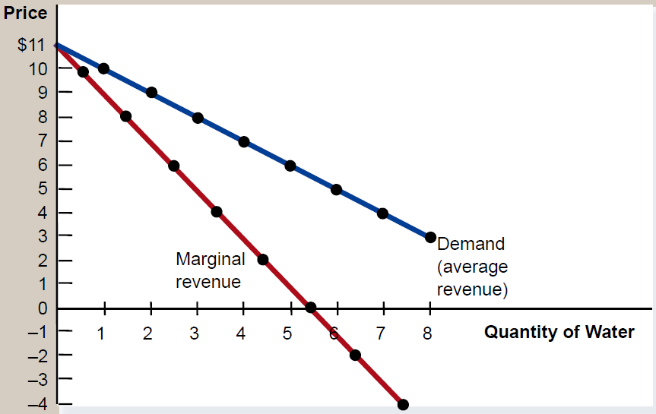
Demand and Marginal-Revenue Curves for a Monopoly

Slide 10
Profit Maximization
A monopoly maximizes profit by producing the quantity at which marginal revenue equals marginal cost.
It then uses the demand curve to find the price that will induce consumers to buy that quantity.
Comparing Monopoly and Competition
For a competitive firm, price equals marginal cost.
P = MR = MC
For a monopoly firm, price exceeds marginal cost.
P > MR = MC

Slide 11
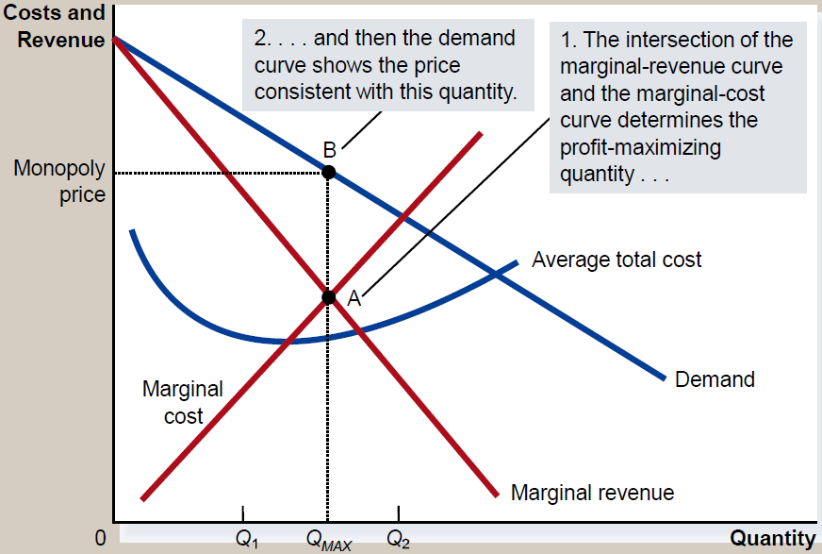
Profit Maximization for a Monopoly

Slide 12
A Monopoly’s Profit
Profit equals total revenue minus total costs.
Profit = TR - TC
Profit = (TR/Q - TC/Q) × Q
Profit = (P - ATC) × Q
The monopolist will receive economic profits as long as price is greater than average total cost.

Slide 13
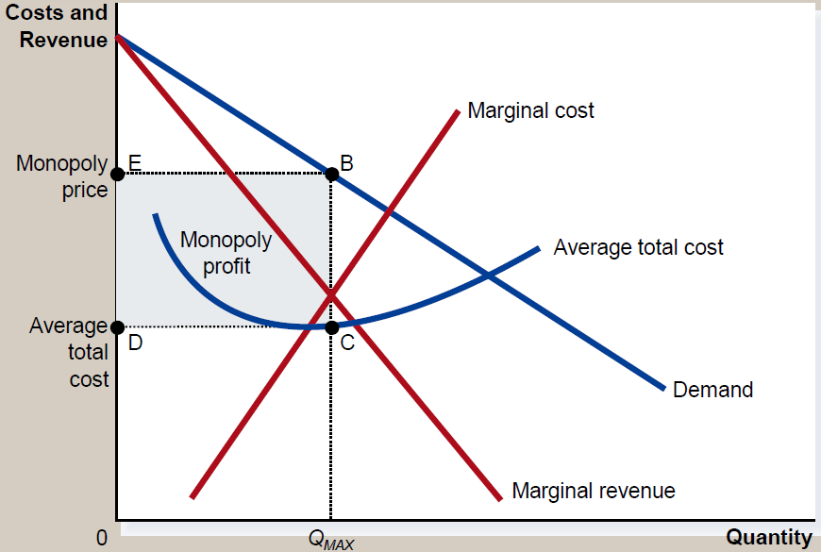
The Monopolist’s Profit

Slide 14
THE WELFARE COST OF MONOPOLY
In contrast to a competitive firm, the monopoly charges a price above the marginal cost.
From the standpoint of consumers, this high price makes monopoly undesirable.
However, from the standpoint of the owners of the firm, the high price makes monopoly very desirable.

Slide 15
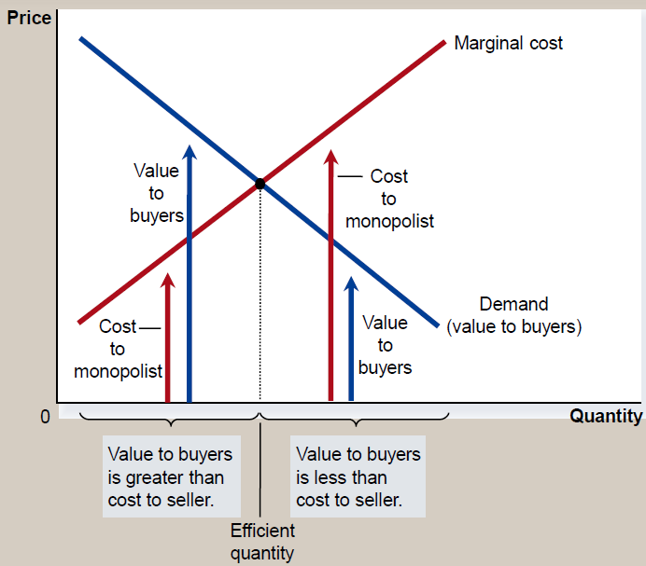
The Efficient Level of Output

Slide 16
The Deadweight Loss
Because a monopoly sets its price above marginal cost, it places a wedge between the consumer’s willingness to pay and the producer’s cost.
This wedge causes the quantity sold to fall short of the social optimum.
The Inefficiency of Monopoly
The monopolist produces less than the socially efficient quantity of output.
The deadweight loss caused by a monopoly is similar to the deadweight loss caused by a tax.
The difference between the two cases is that the government gets the revenue from a tax, whereas a private firm gets the monopoly profit.

Slide 17
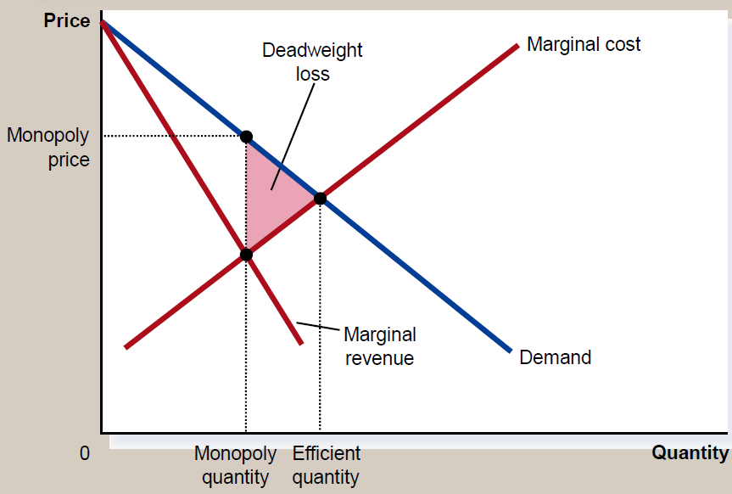
The Inefficiency of Monopoly

Slide 18
PUBLIC POLICY TOWARD MONOPOLIES
Government responds to the problem of monopoly in one of four ways.
Making monopolized industries more competitive.
Regulating the behavior of monopolies.
Turning some private monopolies into public enterprises.
Doing nothing at all.
Increasing Competition with Antitrust Laws: Antitrust laws are a collection of statutes aimed at curbing monopoly power.
Antitrust laws give government various ways to promote competition.
They allow government to prevent mergers.
They allow government to break up companies.
They prevent companies from performing activities that make markets less competitive.

Slide 19
PUBLIC POLICY TOWARD MONOPOLIES
Regulation:
Government may regulate the prices that the monopoly charges.
The allocation of resources will be efficient if price is set to equal marginal cost.
In practice, regulators will allow monopolists to keep some of the benefits from lower costs in the form of higher profit, a practice that requires some departure from marginal-cost pricing.
Public Ownership: Rather than regulating a natural monopoly that is run by a private firm, the government can run the monopoly itself (e.g. in the United States, the government runs the Postal Service).
Doing Nothing: Government can do nothing at all if the market failure is deemed small compared to the imperfections of public policies.

Slide 20
PRICE DISCRIMINATION
Price discrimination is the business practice of selling the same good at different prices to different customers, even though the costs for producing for the two customers are the same.
Price discrimination is not possible when a good is sold in a competitive market since there are many firms all selling at the market price. In order to price discriminate, the firm must have some market power.
1) Perfect Price Discrimination/First Degree Price Discrimination:
Perfect price discrimination refers to the situation when the monopolist knows exactly the willingness to pay of each customer and can charge each customer a different price.
Two important effects of price discrimination:
It can increase the monopolist’s profits by the amount of consumer Surplus. So, Market surplus=Producer Surplus + Consumer Surplus
No dead weight loss.
Examples of Price Discrimination: Movie tickets, Airline prices, Discount coupons, Financial aid, Quantity discounts, Patient discount.

Slide 21
Price Discrimination
2) Second Degree Price Discrimination/Product Versioning:
when a company charges a different price for different quantities consumed, such as quantity discounts on bulk purchases.
Example: Buy 4 get 1/ Bulk discount.
3) Third Degree Price Discrimination/Group Pricing:
when a company charges a different price to different consumer groups. For example, moviegoers may be subdivided into seniors, adults and children, each paying a different price when seeing the same movie at one theater. Example: Student Discount, Senior citizen Discount, Children Discount, Discount for disabled persons.

